Slide 1
MOVIE TICKET BOOKING SYSTEM
CAPSTONE PROJECT PRESENTATION
PROGRAMMING IN PYTHON - CSA0801
PRESENTED BY:
S.AARATHANA - 1921260021
AYESHA SIDDIQUA A - 1911260141
GUIDED BY:
BY:
DR.SAMSON EBENEZAR

Slide 2


INTRODUCTION
The Movie Ticket Booking System is a menu-driven application developed using Python. It uses a MySQL database to store movie details and ticket booking information.
The system allows the user to:
View the list of available movies
Book tickets for a selected movie
Automatically calculate the total ticket amount
All data is stored securely in the database, reducing manual work and errors. This project shows how Python programs can interact with databases to perform real-time operations.

Slide 3
OBJECTIVES
To manage movie details using a MySQL database.
To search, add, update, and delete movie records.
To book and cancel movie tickets easily.
To manage snack orders along with movie bookings.
To calculate movie, snack, and combined bills.
To identify most-watched and top movies based on bookings.
To demonstrate Python–MySQL connectivity and database operations.

Slide 4
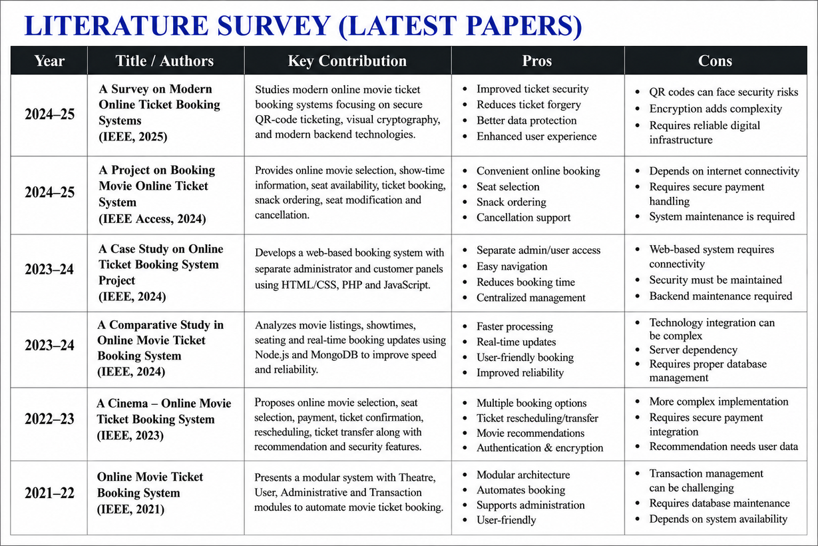

Slide 5
METHODOLOGY
• Requirement Analysis – Identify the requirements for movie booking, movie management, snacks, ratings and billing.
• System Design – Design separate Staff and Customer portals with different functionalities.
• Database Design – Store movies, bookings, snacks and ratings in a MySQL database.
• Python Development – Implement the system using Python functions, user input and SQL queries.
• MySQL Connectivity – Connect Python with MySQL using the mysql.connector module.
• Module Development – Develop login, movie management, ticket booking, snacks, billing, ratings and reporting modules.
• Testing – Test valid inputs, invalid inputs, bookings, cancellations and database operations.
• Implementation – Integrate all modules into a complete Movie Ticket Booking System.

Slide 6
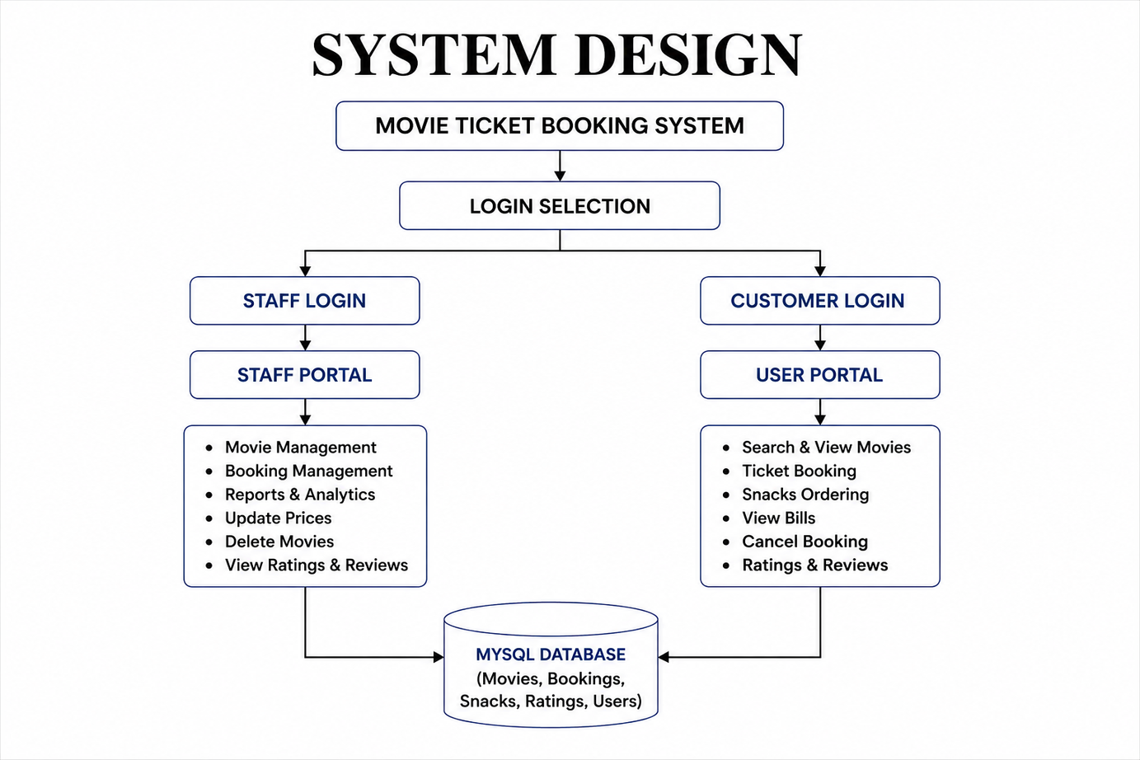

Slide 7
MODULE 1 - REGISTRATION
&
LOGIN USER REGISTRATION
• Provides separate login options for Staff and Customers.
• Staff login verifies Staff ID and password.
• Customer login verifies username and password.
• Invalid staff credentials are denied access.
• Successful login redirects the user to the appropriate portal.

Slide 8
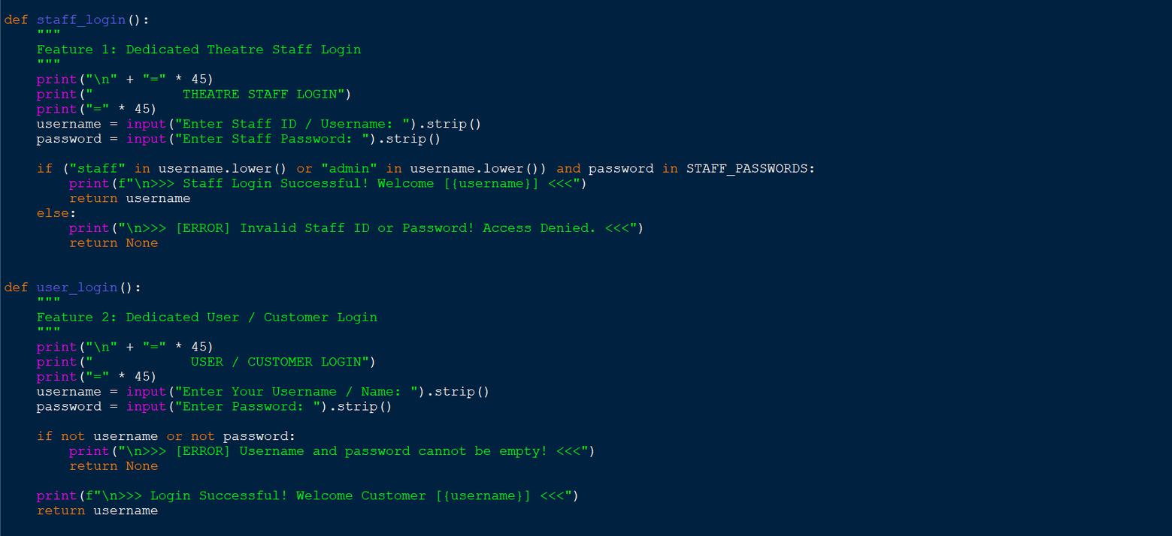
CODE: LOGIN MODULE

Slide 9
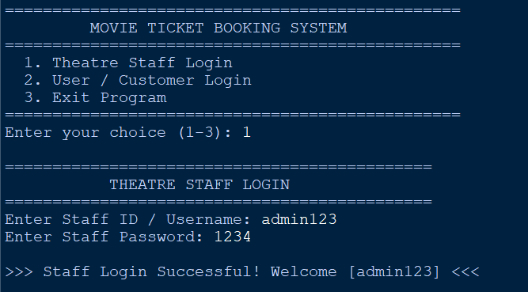
OUTPUT: LOGIN MODULE
CLIENTS SECTION

Slide 10
MODULE 2: MOVIE MANAGEMENT
• Display all available movies.
• Add new movies to the database.
• Search movies by ID or name.
• Search movies by language.
• Search movies by price range.
• Update movie ticket prices.
• Delete movies from the database.
• All movie records are managed using MySQL.

Slide 11
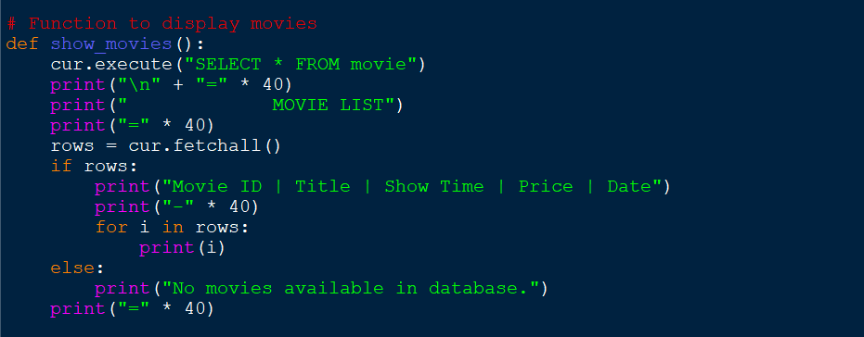
CODE: MOVIE MANAGEMENT
CLIENTS SECTION

Slide 12
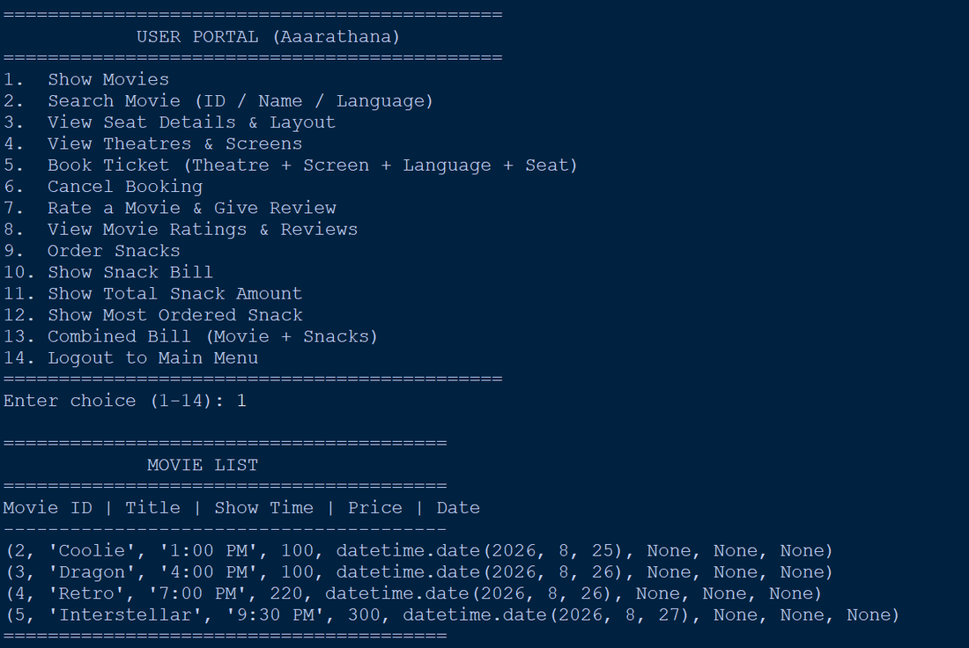
OUTPUT: MOVIE MANAGEMENT
CLIENTS SECTION

Slide 13
MODULE 3-MOVIE & BOOKING MANAGEMENT
STAFF / ADMIN SIDE
• Add new movies to the system
• Update movie ticket prices
• Delete movie records
• View available movie records
• View customer booking records
• Count bookings for a particular movie
• Manage movie and booking information using MySQL

Slide 14
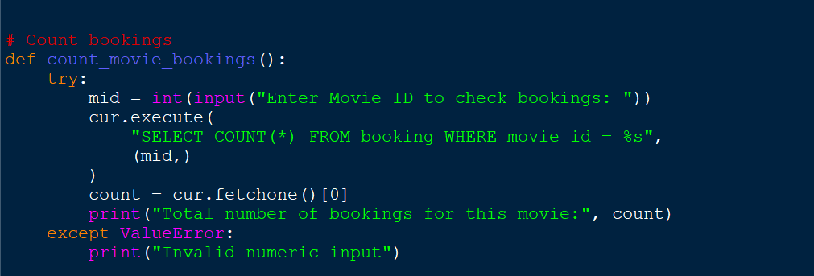
CLIENTS SECTION
CODE: MOVIE MANAGEMENT

Slide 15
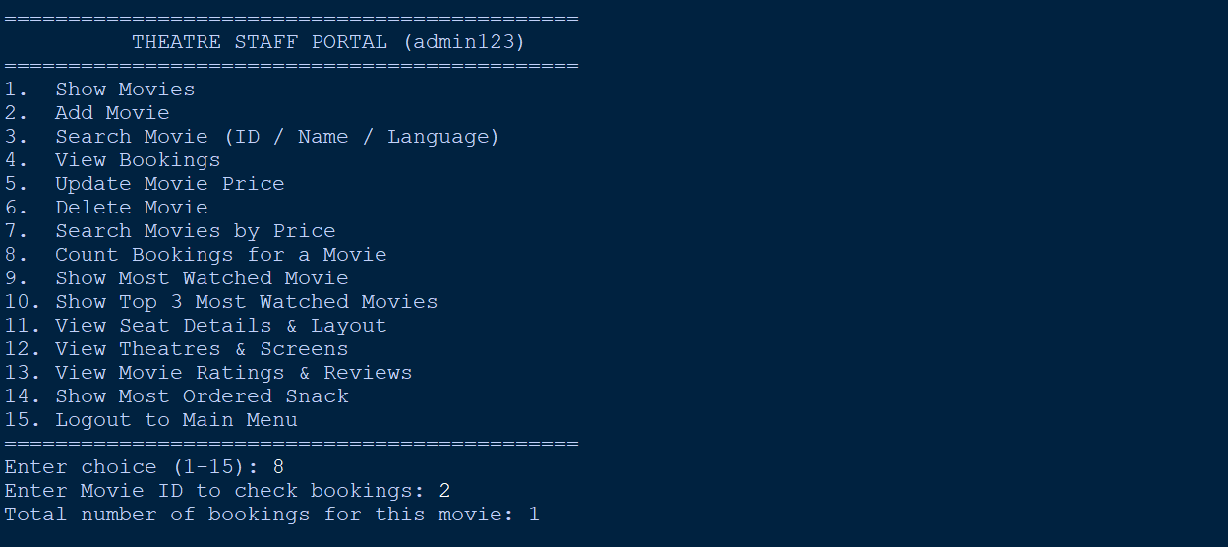
OUTPUT: MOVIE MANAGEMENT

Slide 16
CLIENTS SECTION
MODULE 4-REPORTS,SNACKS
&
BILLING MOST-WATCHED MOVIE
Reports
Most-Watched Movie
Top 3 Most-Watched Movies
Snacks
Show Snack Bill
Total Snack Amount
Most-Ordered Snack
Billing
Combined Movie + Snack Bill
Displays final grand total

Slide 17
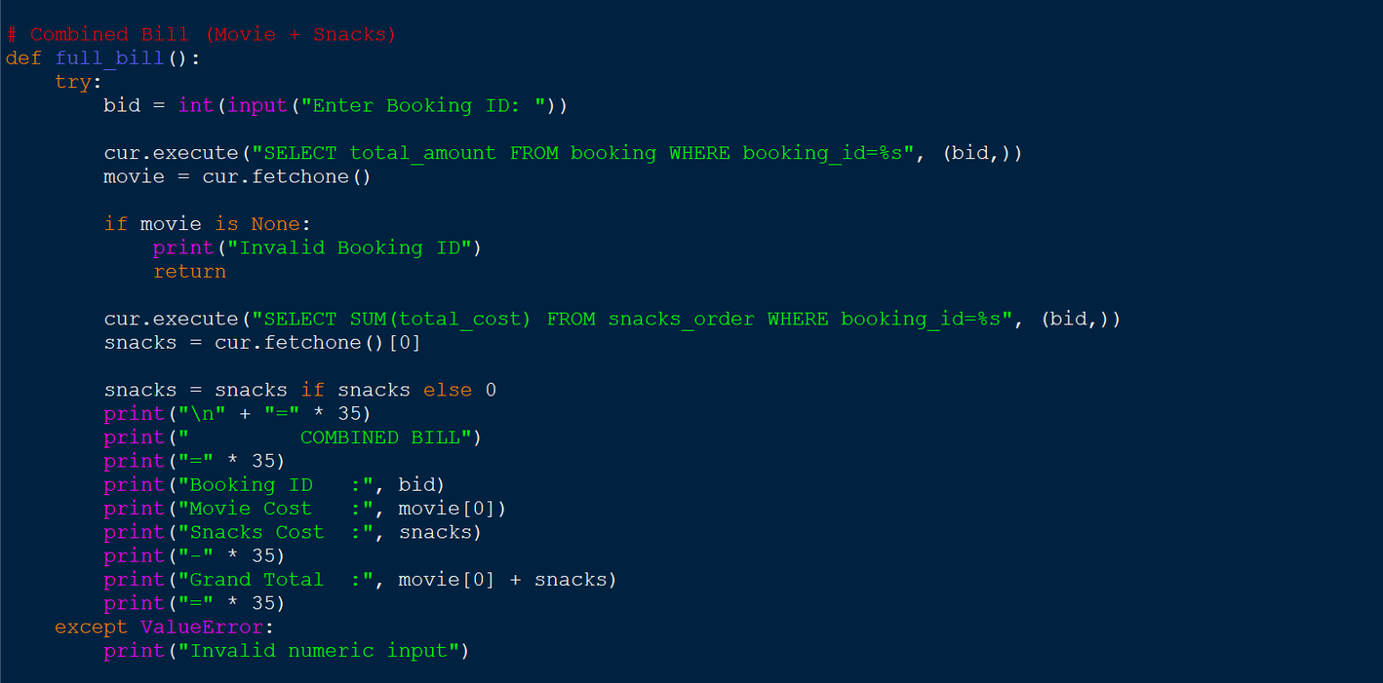
CODE: SNACKS BILLING

Slide 18
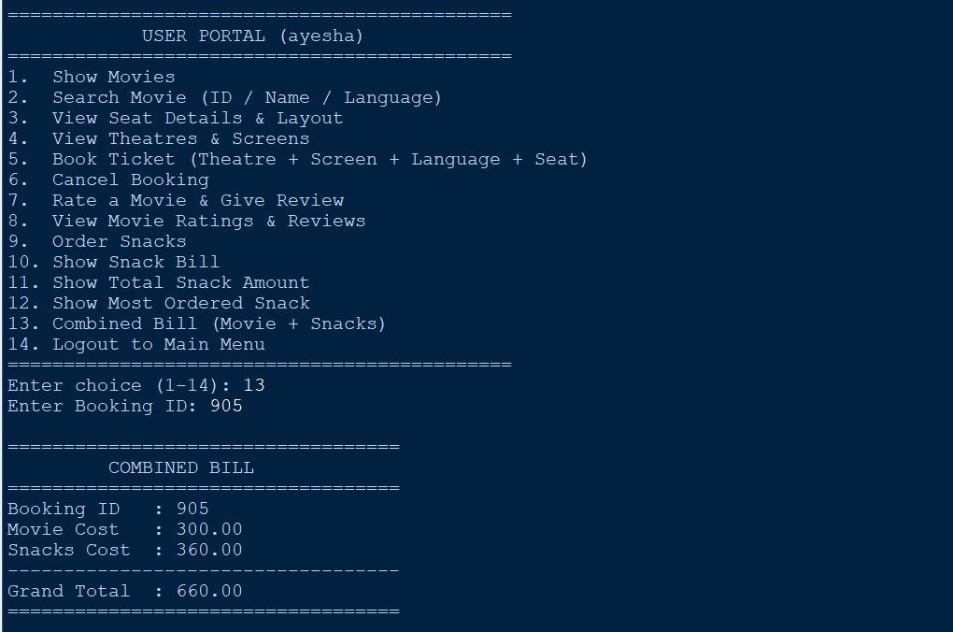
OUTPUT: SNACKS BILLING

Slide 19
IMPLEMENTATION
• Developed using Python programming.
• MySQL is used for persistent data storage.
• mysql.connector provides database connectivity.
• Functions are used to organize different operations.
• SQL queries perform database operations.
• Exception handling manages invalid inputs and database errors.
• Separate Staff and Customer portals are implemented.
• Database connection is closed when the program exits.

Slide 20
RESULTS & DISCUSSION
• Python successfully connected with MySQL.
• Movie records were successfully displayed and managed.
• Ticket bookings were successfully stored.
• Booking cancellation was implemented.
• Snack orders and bills were successfully calculated.
• Ratings and reviews were stored in the database.
• Most-watched movie and top movie reports were generated.
• Staff and Customer portals worked successfully.

Slide 21
CHALLENGES & LIMITATIONS
• Real-time seat availability is not maintained in the database.
• Staff passwords are predefined in the Python source code.
• Customer authentication is basic.
• The system is console-based.
• Online payment integration is not implemented.
• Theatre and screen information is predefined in the Python program.

Slide 22
FUTURE SCOPE
• Add real-time seat availability.
• Add online payment integration.
• Add email/SMS booking confirmation.
• Add administrator role management.
• Add dedicated theatre, screen and seat tables.
• Add movie posters and trailers.
• Add advanced revenue and sales reports.

Slide 23
CONCLUSION
Developed an efficient Movie Ticket Booking System using Python and MySQL.
Simplifies movie searching, ticket booking, and cancellation.
Provides easy management of movie details and ticket prices.
Allows users to order snacks and calculate snack costs.
Generates a combined bill for movie tickets and snacks.
Helps analyze booking data to identify the most-watched movies.
Reduces manual work and improves accuracy in managing booking records.
Demonstrates the practical use of Python–MySQL connectivity and database operations.

Slide 24
REFERENCES
A. N. Mhetre, M. Kadam, and S. Kalambe, “A Survey on Modern Online Ticket Booking Systems,” International Journal of Scientific Research in Computer Science, Engineering and Information Technology, vol. 10, no. 6, pp. 981–987, 2024. DOI: 10.32628/CSEIT2410460.
O. Thakre, A. Pawar, S. Raut, S. Kharge, and A. Shaik, “A Project on Booking Movie Online Ticket System,” International Journal of Innovative Science and Research Technology, vol. 9, issue 3, 2024. DOI: 10.38124/ijisrt/24mar1247.
K. Acharya, “A Case Study on Online Ticket Booking System Project,” SSRN, 2024. DOI: 10.2139/ssrn.4841210.
A. Roy, V. Shahdeo, and R. Kaluri, “A Comparative Study in Online Movie Ticket Booking System,” 2021. This work is also listed in the reference section of Mhetre et al.'s 2024 survey.
5.B. Harshitha, P. B. S. Jyothi, K. L. Phanindra, T. P. Venkat, and B. T. S. S. Srihari Krishna Gopal, “Movie Ticket Booking System for Multiplex Theatre: A Conceptual Framework for Design, Architecture, and User Experience.”

Slide 25
THANK YOU

